Slide 1
Opening a delivery service in New York City
Focusing on Indian Restaurants

Slide 2
Our client wants to set up a delivery service of indian food in NYC
Our job is to decide where to set up the delivery hubs/centers
The client wants these hubs to be located close to the indian restaurants in town to optimize deliver times

Slide 3
Methodology
Collect New York City location data
Overview the city’s neighborhoods
Specify where the indian restaurants are located
Perform machine learning to optimize where the hubs should be placed, so that they are right in the center of each cluster

Slide 4
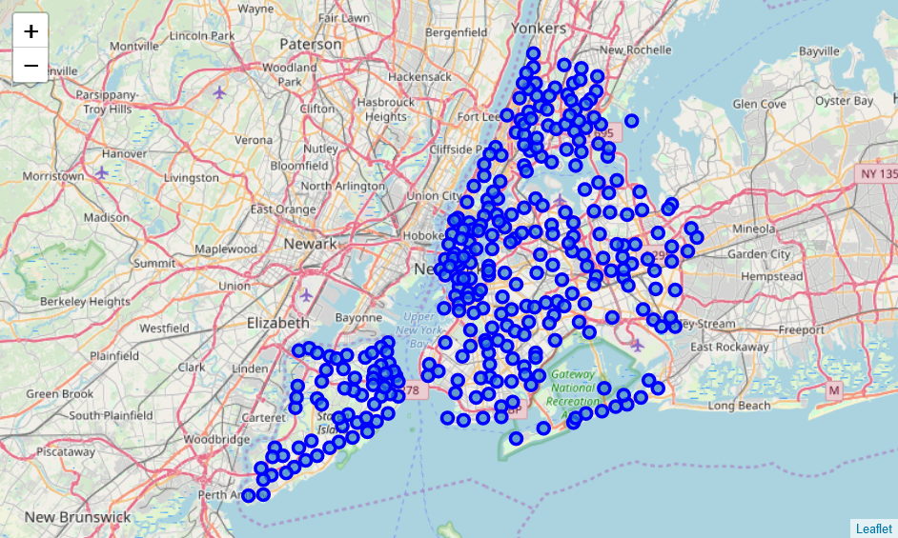
Neighborhoods in NYC
Here we can see all the different neighborhoods of NYC in a map

Slide 5

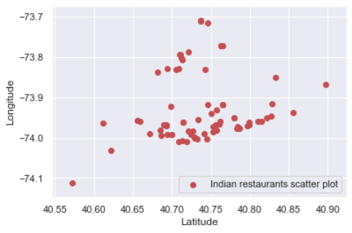
Plot the indian restaurants on latitude/longitude data
Client wants 4 hubs, we will deliver

Slide 6
Machine learning
We will run a k-means algoritm to tell us where the centers of these hubs should be
The data suggests these 4 location points:
40.78798302, -73.94642381
40.72579975, -73.78655571
40.70861378, -73.98285651
40.60225783, -74.03578544

Slide 7
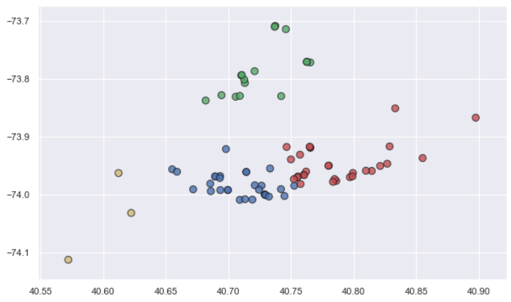
Finally, the clusters on a plot
The 4 cluster are specified by different colors

